Slide 1
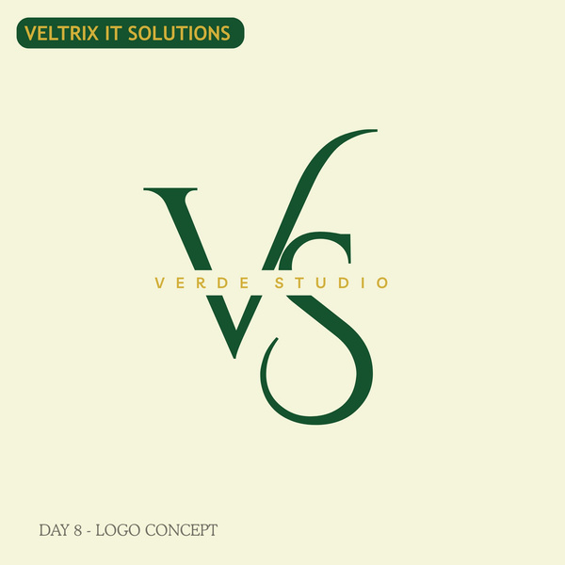
VERDE STUDIO
BUSINESS PRESENTATION
Creative Solutions for Modern Brands

Slide 2


ABOUT US!
Verde Studio is a creative agency dedicated to helping businesses build strong and memorable brand identities. We specialize in branding, graphic design, social media content, and digital solutions that help companies grow in the modern market. Our focus is to deliver creative, professional, and impactful designs that connect brands with their audience.

Slide 3
WHAT WE OFFER
ALWAYS
Branding – Creating unique brand identities through colors, fonts, and visual style.
Marketing Support – Providing creative materials and visuals to help businesses promote their services effectively.
Web Design – Building clean and modern website layouts that improve user experience.
Logo Design – Creating professional and memorable logos that represent a business clearly.
Social Media Design – Designing attractive posts and content for Instagram, Facebook, and other platforms.

Slide 4



WHY CHOOSE US!
Creative Team
Modern Designs
Fast Delivery
Professional Support
Affordable Pricing

Slide 5

THANK YOU
VISIT US
+123-456-7890
www.verdestudio.com

